Slide 1
Data Management for Data Science
Lecture 24: Data Vizualization
Prof. Asoc. Endri Raço

Slide 3
John Snow
Hypothesis at the time:
Diseases such as cholera and bubonic plague are caused by pollution or a noxious form of "bad air”.
John Snow’s Research:
The source of the outbreak was the public water pump
[On the Mode of Communication of Cholera]

Slide 4
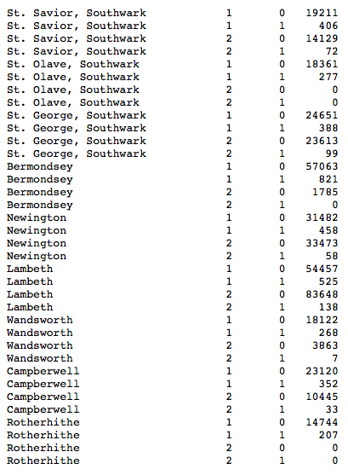
How did he do it?
Death/Survival in cholera in 19th century London by district and water company.

Slide 5
How did he do it?
Snow's data visualization study is regarded as the founding event of the science of epidemiology.

Slide 6
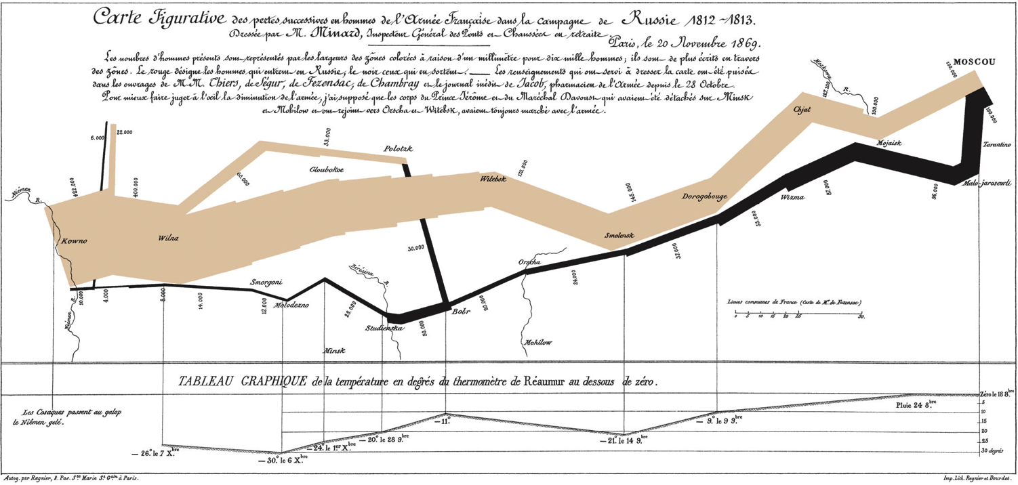
Charles Joseph Minard 1869 Napoleon’s March
According to Tufte: “It may well be the best statistical graphic ever drawn.”
5 variables: Army Size, location, dates, direction, temperature during retreat
https://news.nationalgeographic.com/2017/03/charles-minard-cartography-infographics-history/

Slide 7
Interactivity to Educate
The famous Gapminder Video, Hans Rosling:
200 Countries, 200 Years, 4 Minutes
https://www.youtube.com/watch?feature=player_embedded&v=jbkSRLYSojo

Slide 8
Outline
Visualization:
Some great examples
Some counter-examples
Principles for Visualization Design
Visualization Toolkits preview

Slide 9
Some Anti-Examples
Courtesy of WTFViz.net

Slide 10
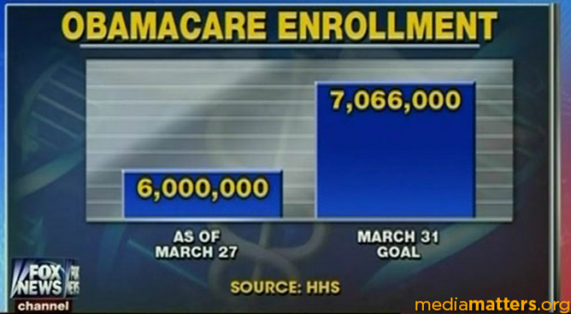
Visualization to Educate?
from wtfviz.net

Slide 11
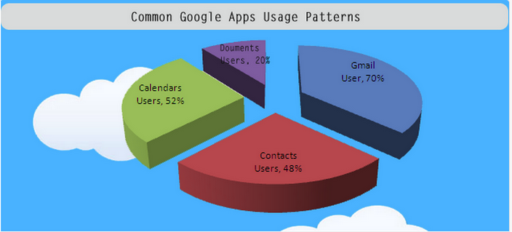
Pie in the Sky?
from wtfviz.net

Slide 12
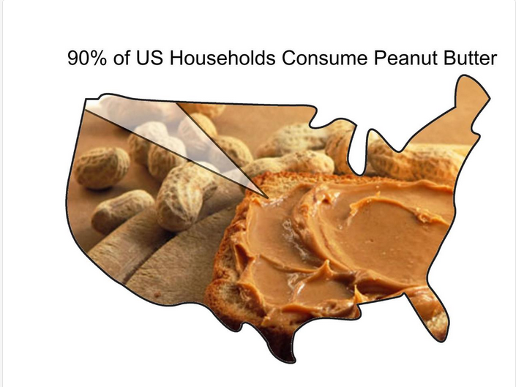
from wtfviz.net

Slide 13
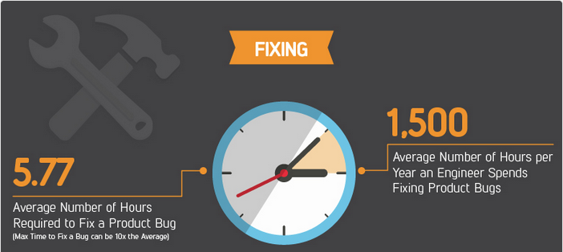
Needs Fixing
from wtfviz.net
Notes:
What does this graphic add to the discussion ?

Slide 14
Outline
Visualization:
Some great examples
Some counter-examples
Principles for Visualization Design
Visualization Toolkits preview

Slide 15
Visualization Definitions
“Transformation of the symbolic into the geometric”
[McCormick et al. 1987]
“... finding the artificial memory that best supports
our natural means of perception.” [Bertin 1967]
“The use of computer-generated, interactive, visual
representations of data to amplify cognition.”
[Card, Mackinlay, & Shneiderman 1999]

Slide 16
Uses for Data Viz
A: Support reasoning about information (analysis)
Finding relationships
Discover structure
Quantifying values and influences
Should be part of a query/analyze cycle
B: Inform and persuade others (communication)
Capture attention, engage
Tell a story visually
Focus on certain aspects, and omit others

Slide 17
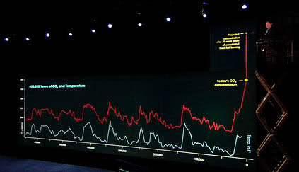
Uses for Data Viz
Notes:
From “an inconvenient truth”

Slide 18
Principle 1
Simplify !

Slide 19
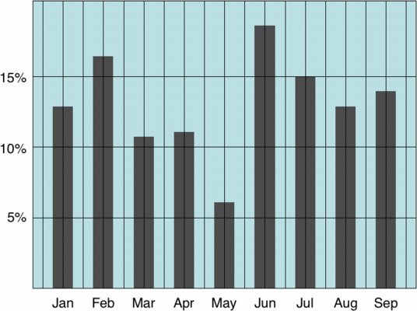
Chart Design: Simplifying
Example from Tim Bray

Slide 20
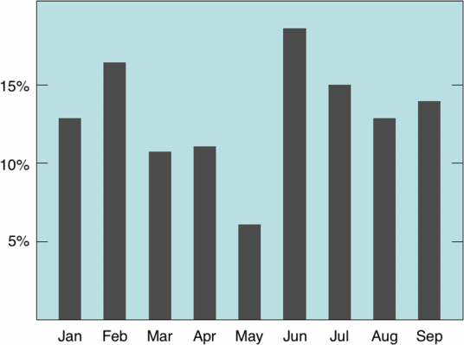
Chart Design: Simplifying
Example from Tim Bray

Slide 21
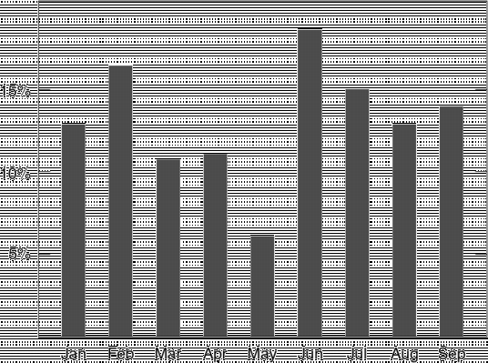
Chart Design: Simplifying
Example from Tim Bray

Slide 22
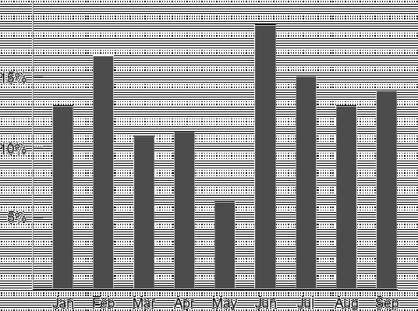
Chart Design: Simplifying
Example from Tim Bray

Slide 23
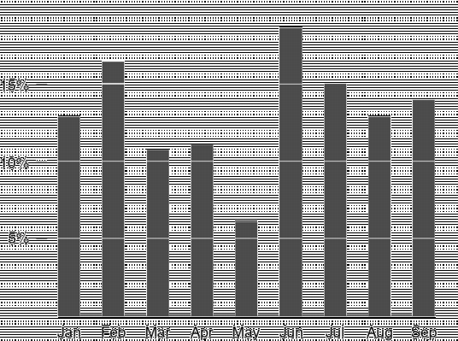
Chart Design: Simplifying
Example from Tim Bray

Slide 24
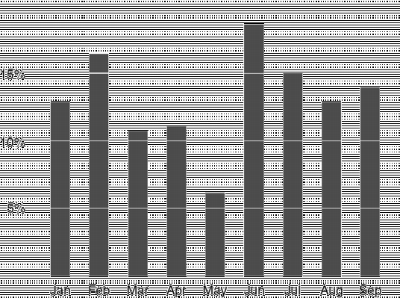
Chart Design: Simplifying
Example from Tim Bray

Slide 25
Principle 1: Simplify
Tables and charts
Reduce chartjunk/tablejunk; increase data-ink ratio
Lessons from perception: Limit the number of objects displayed at once
Beware:
Gratuitous 3D
Shadows
Gratuitous animation
How do you tell if a feature is gratuitous? Ask whether using it reveals more information.

Slide 26
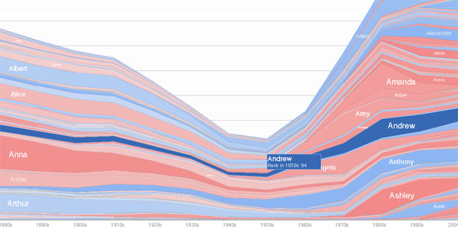
Interactive Chart Design: Simplifying
With interactive charts you can keep things very simple by hiding and dynamically revealing important structure.
On an interactive chart, you reveal the information most useful for navigating the chart.

Slide 27
Principle 2: Understand Magnitudes
Which is brighter?
Notes:
19th century physicist Ernst Weber (discovered in 1846)

Slide 28
Principle 2: Understand Magnitudes
(128, 128, 128)
(144, 144, 144)
Which is brighter?
Notes:
19th century physicist Ernst Weber (discovered in 1846)

Slide 29


Just Noticeable Difference
JND (Weber’s Law)
Ratios more important than magnitude
Most continuous variations in stimuli are perceived in discrete steps
Notes:
Table of just-noticable differences
19th century physicist Ernst Weber (discovered in 1846)
I = intensity of the stimulus
S = sensation
A jnd in sensation is proportional to the magnitude of the original intensity of the stimulus. So as the base I increases
we require a larger changes in delta I to notice the change.

Slide 30
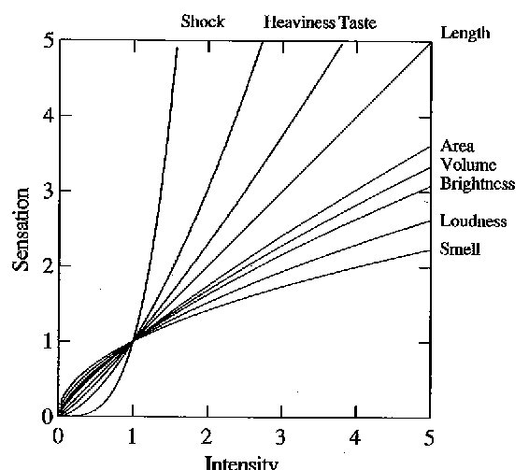
Steven’s Power law
S = sensation
I = intensity
p < 1 : underestimate
p > 1 : overestimate
[graph from Wilkinson 99, based on Stevens 61]
[alternate graph : http://www.undergrad.ahs.uwaterloo.ca/~wchedder/stevenspowerlaw.htm]
Notes:
Directly measure sensation rather than change in sensation – asked subjects to describe stimulus that was “twice as strong”
---
There is an alternative, but equivalent, formulation of the Power Law (found in the second image here) which produces a graph that some might find more appealing. At the very least it addresses the issued raised in class of the curves all intersecting at (1,1).
http://www.undergrad.ahs.uwaterloo.ca/~wchedder/stevenspowerlaw.htm

Slide 31
Compare area of circles
Notes:
1:16

Slide 32
Compare area of circles
Notes:
1:16

Slide 33
Principle 2: Understand Magnitudes
Most accurate Position (common) scale
Position (non-aligned) scale
Length
Slope
Angle
Area
Volume
Least accurate Color hue-saturation-density
Notes:
Cleveland task: estimate the proportion of one element as a percentage of another element
Are these the same as the ranking for discriminating which of two quantities are larger?
The above ordering is based on the revised ranking in this paper (cites evidence that angle is not as good as slope)
Hollands, J. & Spence, I. (2001). The discrimination of graphical elements. Applied Cognitive Psychology, 15, 413-431.

Slide 34
Principle 3: Use Color
Color
Choose colors based on the information you want to convey
Sequential
Diverging
Categorical
Use online resources to discover and record your color schemes
Color Brewer
Kuler
Colour Lovers
Where possible, use your organization’s palette

Slide 35
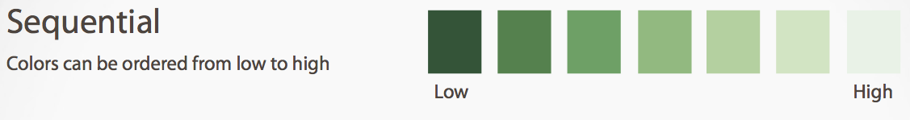
Principle 3: Use Color
Color

Slide 36
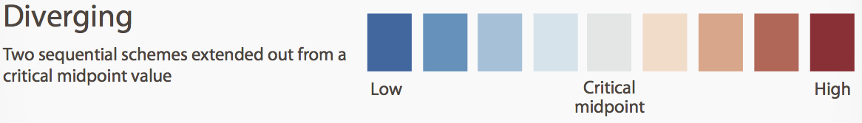
Principle 3: Use Color
Color

Slide 37

Principle 3: Use Color
Color

Slide 38
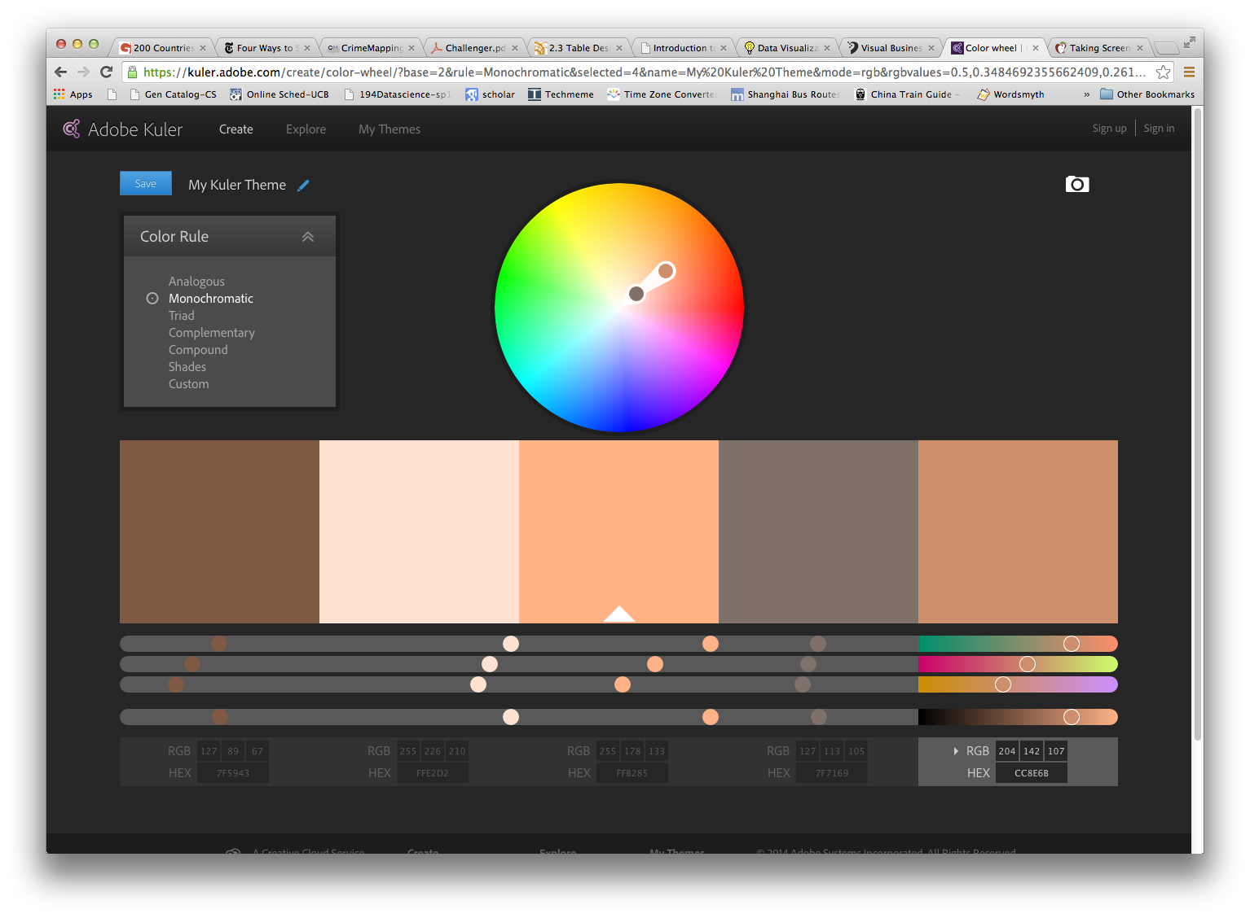
Principle 3: Use Color
Color

Slide 39
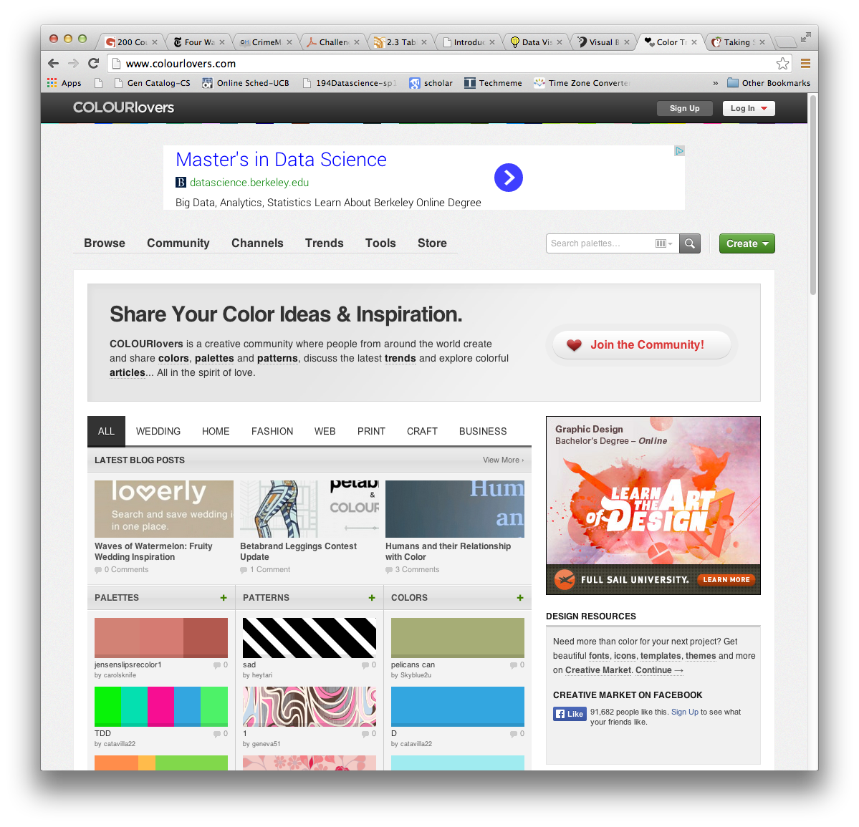
Principle 3: Use Color
Color

Slide 40
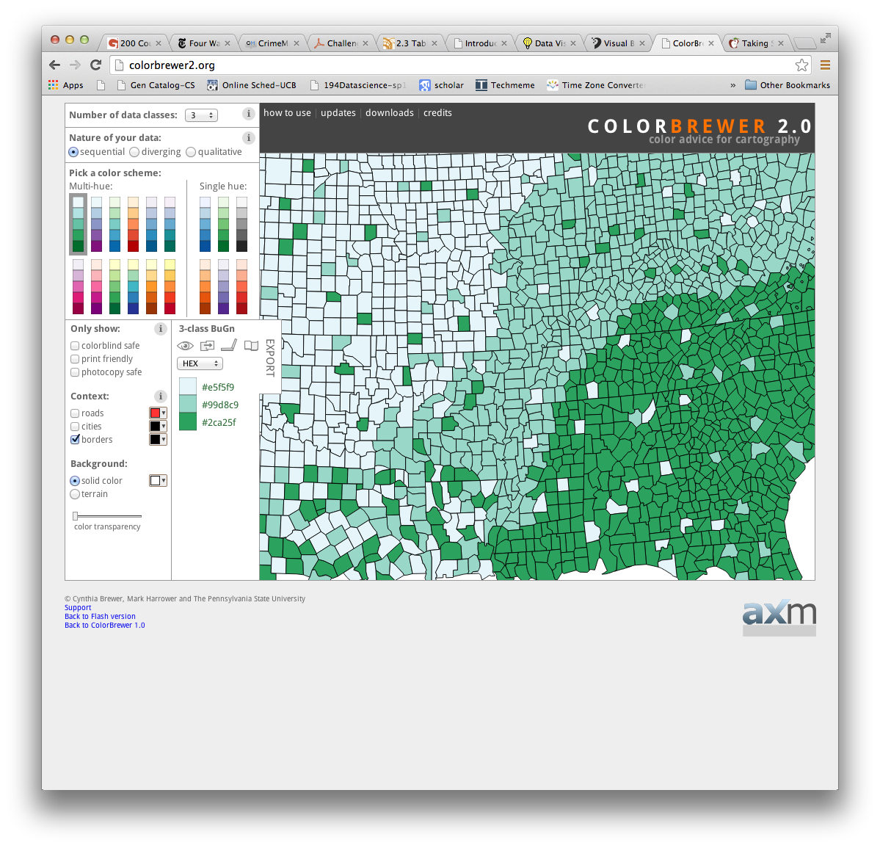
Principle 3: Use Color
Color

Slide 41
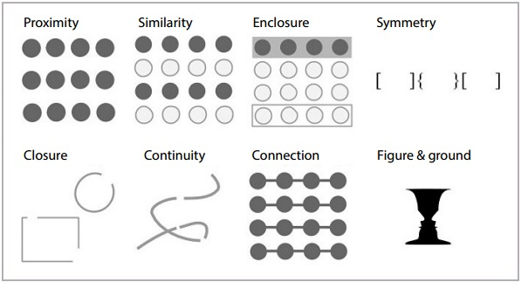
Principle 4: Use Structure
Gestalt Psychology principles (1912):
Source http://blog.fusioncharts.com/2014/03/how-to-use-the-gestalt-principles-for-visual-storytelling-podv/

Slide 42
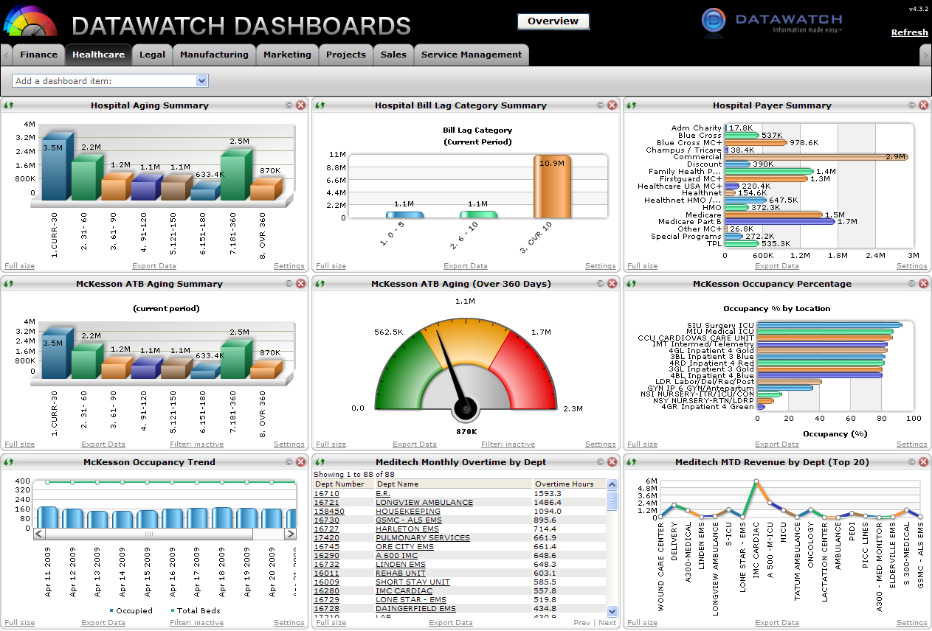
Principle 4: Use Structure (but not like this)
Source https://www.vocalabs.com/blog/my-dashboard-pet-peeve

Slide 43
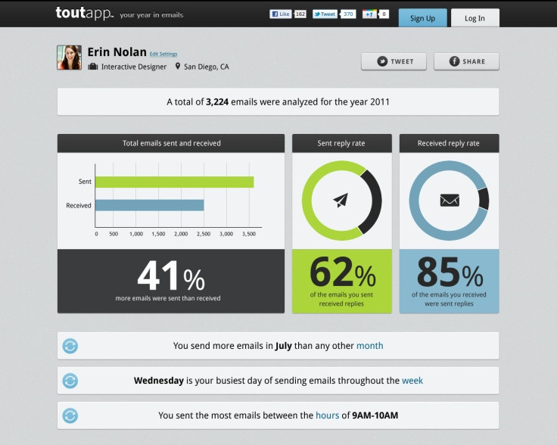
Principle 4: Use Structure
Source https://www.vocalabs.com/blog/my-dashboard-pet-peeve

Slide 44
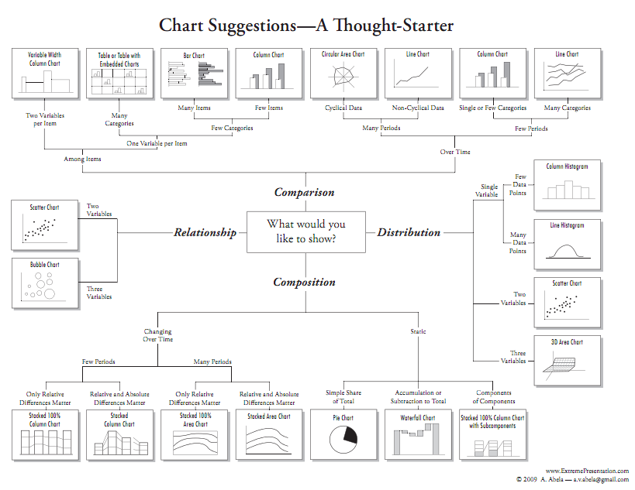
Chart Selection – Andrew Abela

Slide 45
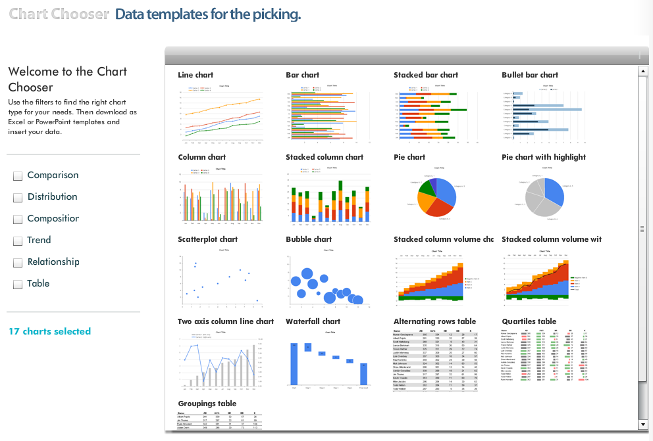
Chart Selection – Juice Analytics

Slide 46


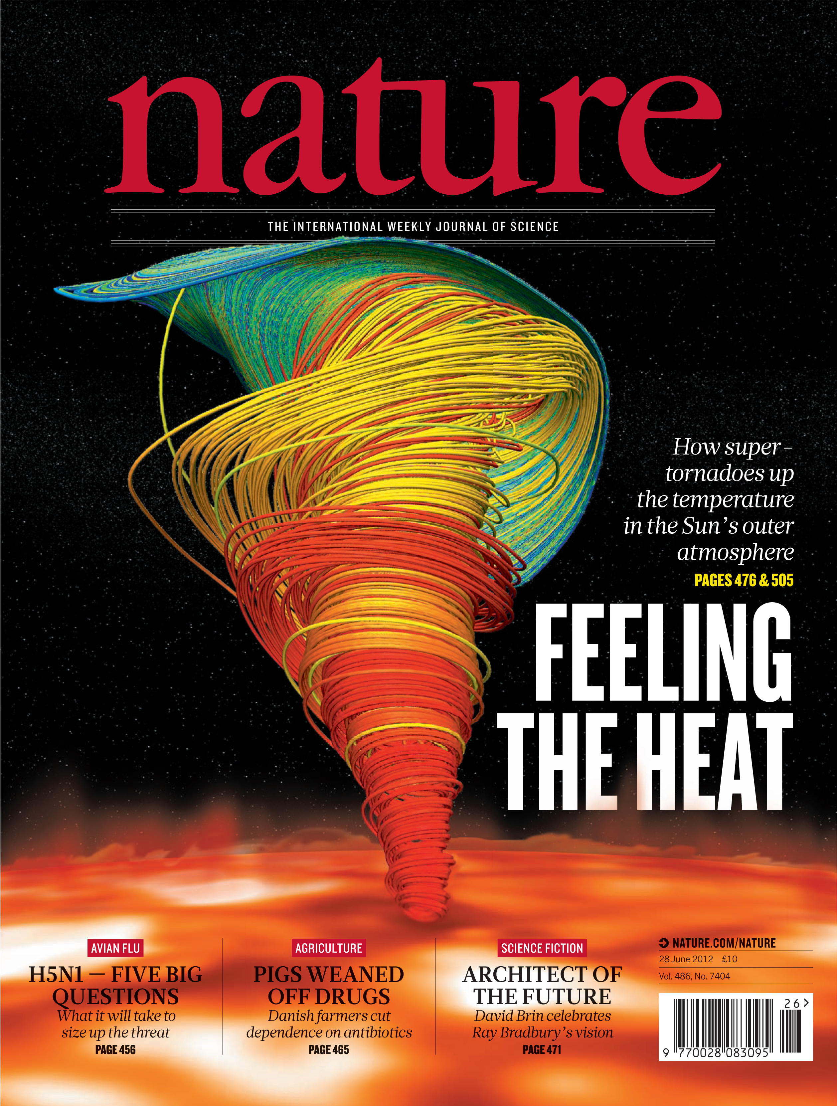

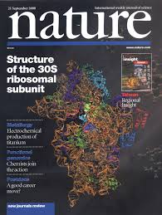

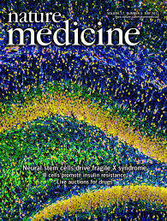

Data Viz in the Sciences

Slide 47
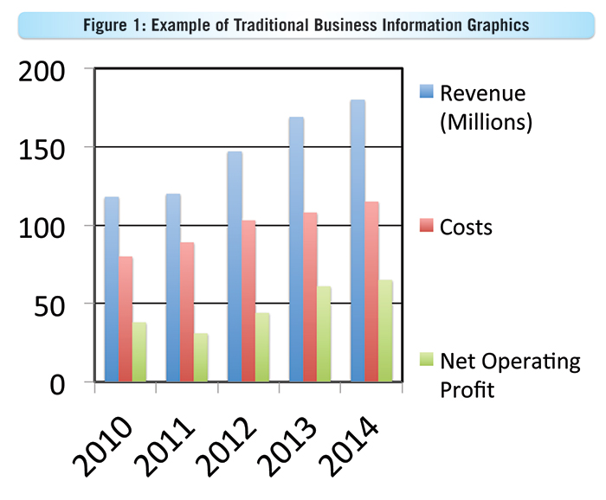
A case for Ugly visualizations
People instinctively gravitate to attractive visualizations, and they have a better chance of getting on the cover of a journal.
But does this conflict with the goals of visualization?:
Rapid exploration
Focus on most important details
Easy and fast to develop and customize
e.g. Powerpoint vs Keynote

Slide 48
Outline
Visualization:
Some great examples
Some counter-examples
Principles for Visualization Design
Visualization Toolkits preview

Slide 49
Interactive Toolkits: D3
Without Doubt, the most widely used interactive visualization framework is D3, developed around 2011 by Jeff Heer, Mike Bostock and Vadim Ogievetsky.
Note from the authors: D3 is intentionally a low-level system. During the early design of D3, we even referred to it as a "visualization kernel" rather than a "toolkit" or "framework"

Slide 50
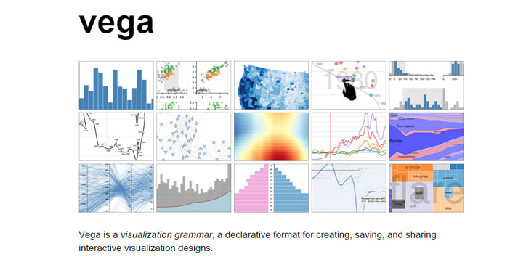
Interactive Toolkits: Vega
Vega is a “visualization grammar” developed on top of d3.js
It specifies graphics in JSON format.

Slide 51
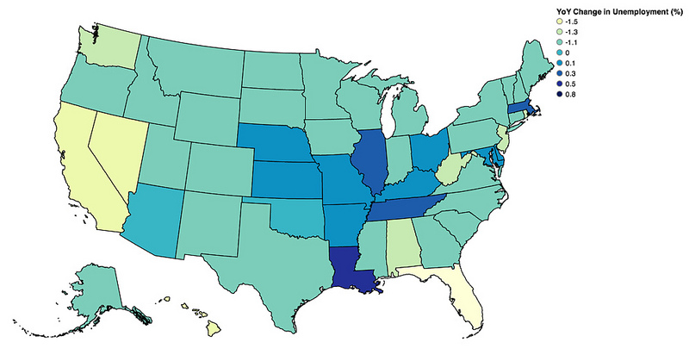
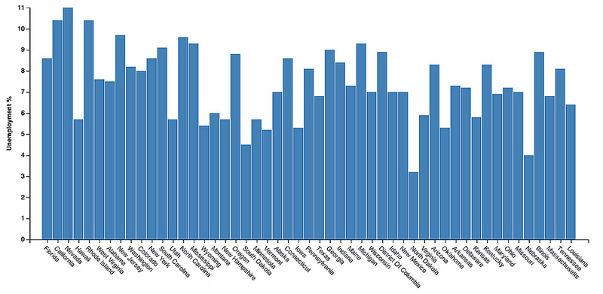
Interactive Toolkits: Vincent
Vincent is a Python-to-Vega translator.
Trivia question: why is it called Vincent? Hint: Vincent+Vega= ?

Slide 52

Interactive Toolkits: Vincent
Vincent is a Python-to-Vega translator.
Trivia question: why is it called Vincent? Hint: Vincent+Vega= ?

Slide 53
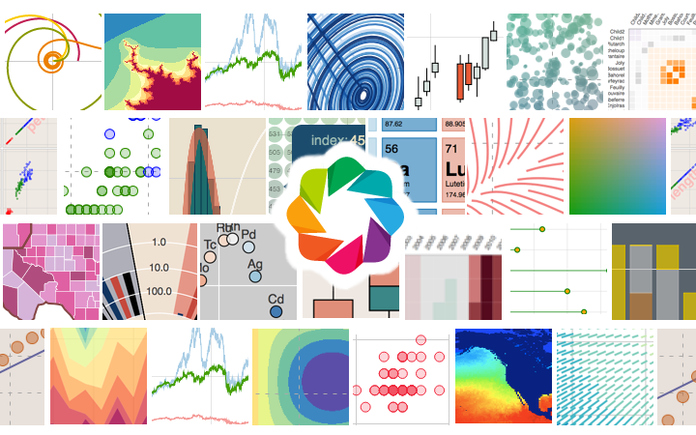
Bokeh: Another Interactive Viz Library
Bokeh is an independent Viz library focused more heavily on big data visualization. Has both Python and Scala bindings.

